Slide 1
Welcome
Coffee Cash
Members: 1. Md. Afique Amin Zian(1631005)
2.Nasik Sami Khan(1638153)
3. Md. Sariful Islam(1626667)
4. Abrar Habib Haque(1636029)

Slide 2
Problem Description:
Vending Machine always use hard cash
Those who doesn’t have hard cash will suffer
Sometimes people have hard cash but with bigger amount
Sometimes the vending machine do not accept notes (looks old or got torn)

Slide 3
Solution:
Vending Machine + ATM Machine = COFFEE CASH
We are planning to provide vending machine which will combined the Vending Machine concept with the ATM machine and some similar IT Advancement to solve similar problems regarding Vending Machine

Slide 4
About Us
Customer Oriented company, using IT systems including RFID, GPS System, Quick Response(QR) Code system
Idea similar to Automatic Teller Machine (ATMs)
High Visibility, High traffic, Zero Downtime
Collaboration with suppliers and manufacturers

Slide 5
Target MArket
The fast-paced individual who has money but no time
Professionals going to work in the morning
University students going for classes every day
Commuters and passengers waiting at various public transport hubs
Shoppers in malls and markets
Tourists walking in the city, sightseeing

Slide 6
Location
High traffic/high visibility spots around Kuala Lumpur
Public transportation stations
Landmarks
Tourism sites
Shopping complexes
Universities
Banks
Hospitals

Slide 7
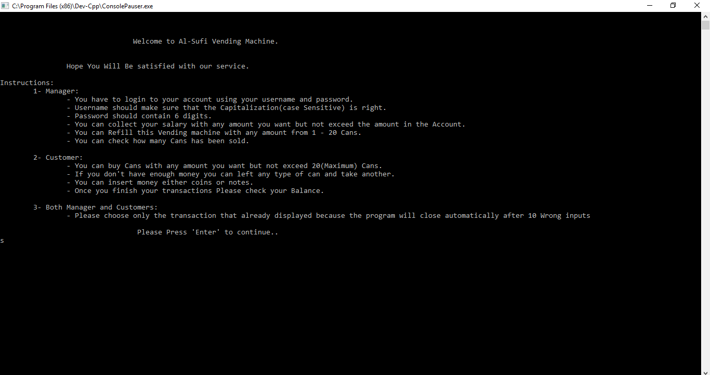
Topic we Covered
Input & Output
Control Structures
Functions
Arrays[1D]
Files
Pointer
Structure
External file

Slide 8
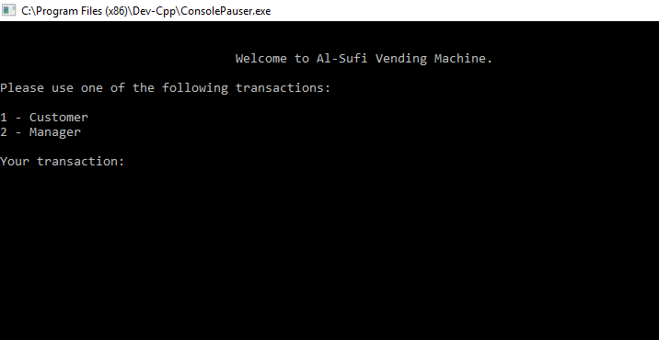
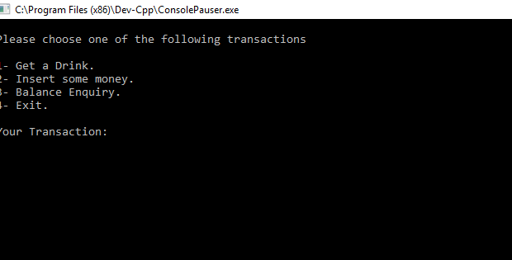
Dealing with two part in this program:
a)Customers
b)Managers
2. Customers can by their products
- Insert Money
- Choose drinks
-collect reciept

Slide 9
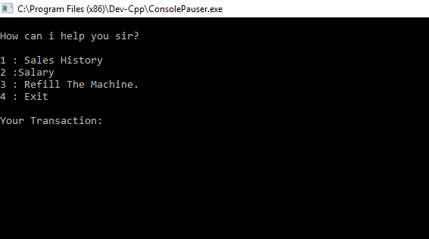
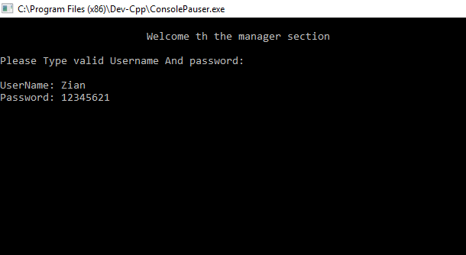
3. Managers of this machine
- check the purchase history
-get their salary
-refill the machine
But they need to login first with Valid
Username and Password.

Slide 10
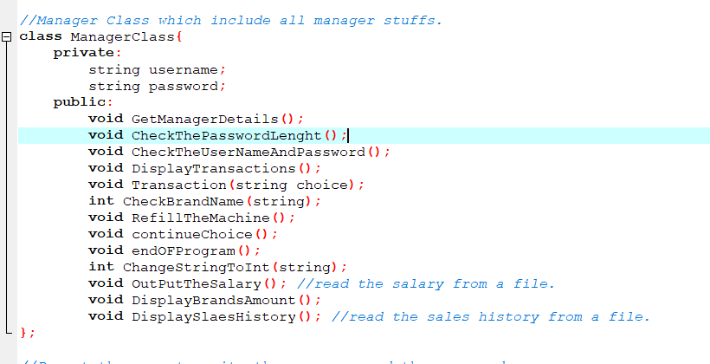
In This project:
a) Manager class Has 15 Functions: We also Use Class (Private and Public)

Slide 11
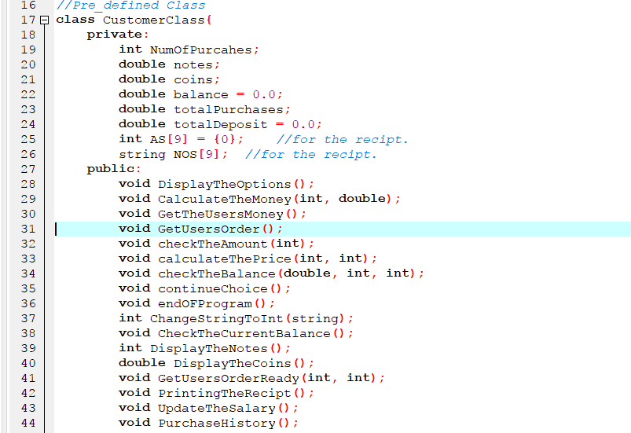
In This project:
Customer class has 21 Functions. With Public and Private class.

Slide 12
We also use different kinds of libraries for running the program successfully.
These are:
#include <windows.h>
#include <algorithm>
#include <iostream>
#include <iomanip>
#include <sstream>
#include <fstream>
#include <string>
#include <vector>
#include <cmath>
#include <set>

Slide 13
> The Input has to go through Some tests to make sure that it’s Valid
> The Program saves all purchase in a file, to give the user receipt at the end.
> You can check your salary , remaining items, purchase history through the file (Allowed to the managers)
>we provided comments to understand what happened in the code by reading the code wisely.

Slide 14
Robustness:
a) The program takes all inputs as string and it is able to change the datatype of the input by using specific function.
b) The program can not be crashed or goes infinite loop and display different message depends on the input.

Slide 15
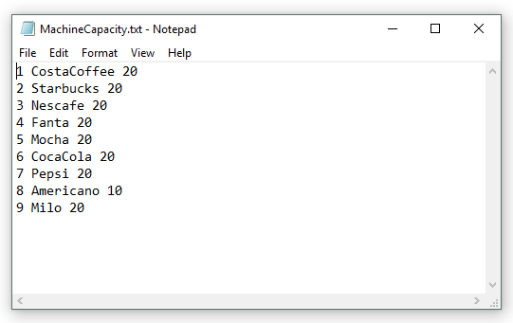
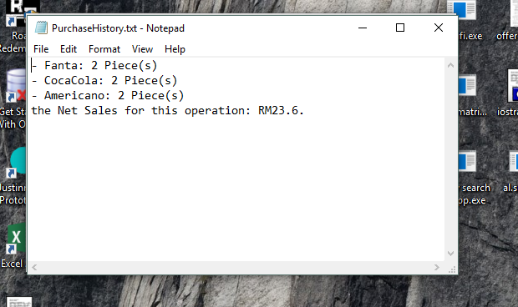
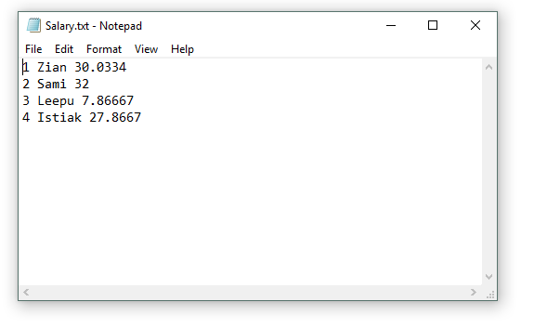
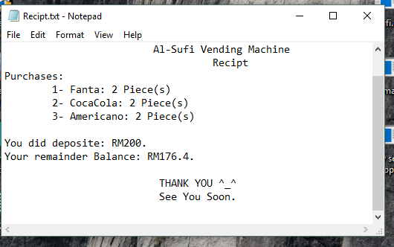
The receipt Files copy , salary copy and also the purchase history:

Slide 16
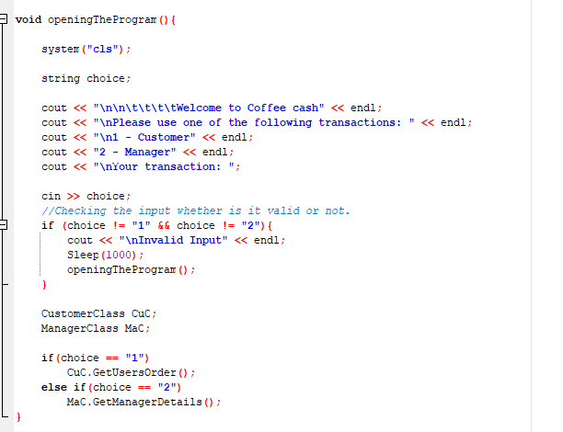
Time Complexity
Time Complexity = O(1)
As its a if else statement so every program will be run a Constant time.

Slide 17
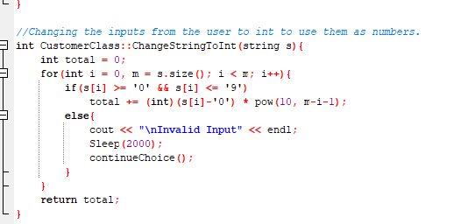
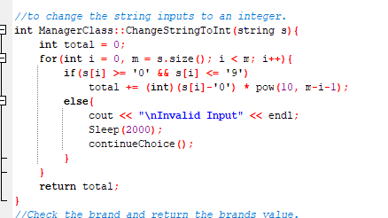
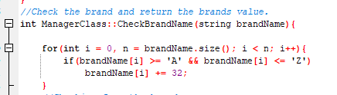
Time Complrxity:
1+ (0+1+2+3+4….+n-1)+c+c
(n-1)(n-1+1)/2
=O(n^2)

Slide 18
Conclusion
Brings to the market something new and unique
Has great potential to be successful company
Innovative implication and technological applications
Provides the services that everyone needs, but no one realizes

Slide 19
Thanks For Watching

